Slide 1
Final Presentation ADV
Tiago Ferreira Fernandes 2017242427 MECD

Slide 2
Conceptualization
Câmara Municipal do Porto
Understand the impact of the COVID-19 pandemic in Porto over 1 year

Slide 3
Initial Idea
Average prices per month by neighbourhood – Geographic visualization
Variation of the prices of each listing individually – Time Series visualization
Montly statistics (average and standard deviation) – Bar visualization
Extra information about the number of bedrooms, beds, bathrooms, average price of cleaning fee per neighbourhood,… - Bar and Pie visualization

Slide 4
Data Preparation
Data separated by various files (calendar.csv – price information, listings.csv – other information)
Data Cleaning (floats to int, string to date format, NaN to zero, remove unnecessary columns)
Put it all together in the same file
Notes:
- Other information: localização (coordenadas), zona a que pertence, número de quartos e camas, número de casas de banho, etc…

Slide 5
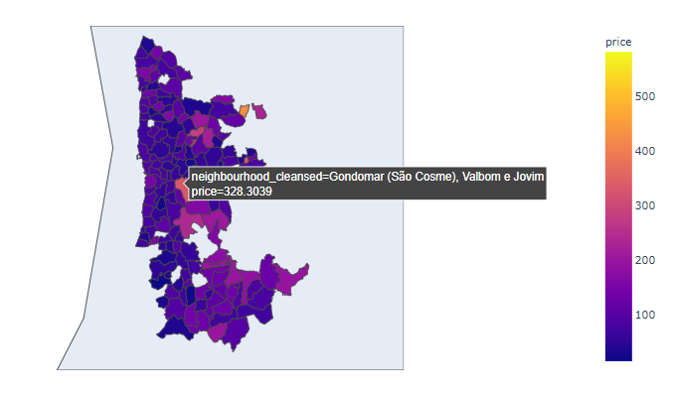
Notes:
- Inicialmente estava a dar zoom na Europa, o que envolve muito scroll até à região do Porto

Slide 6
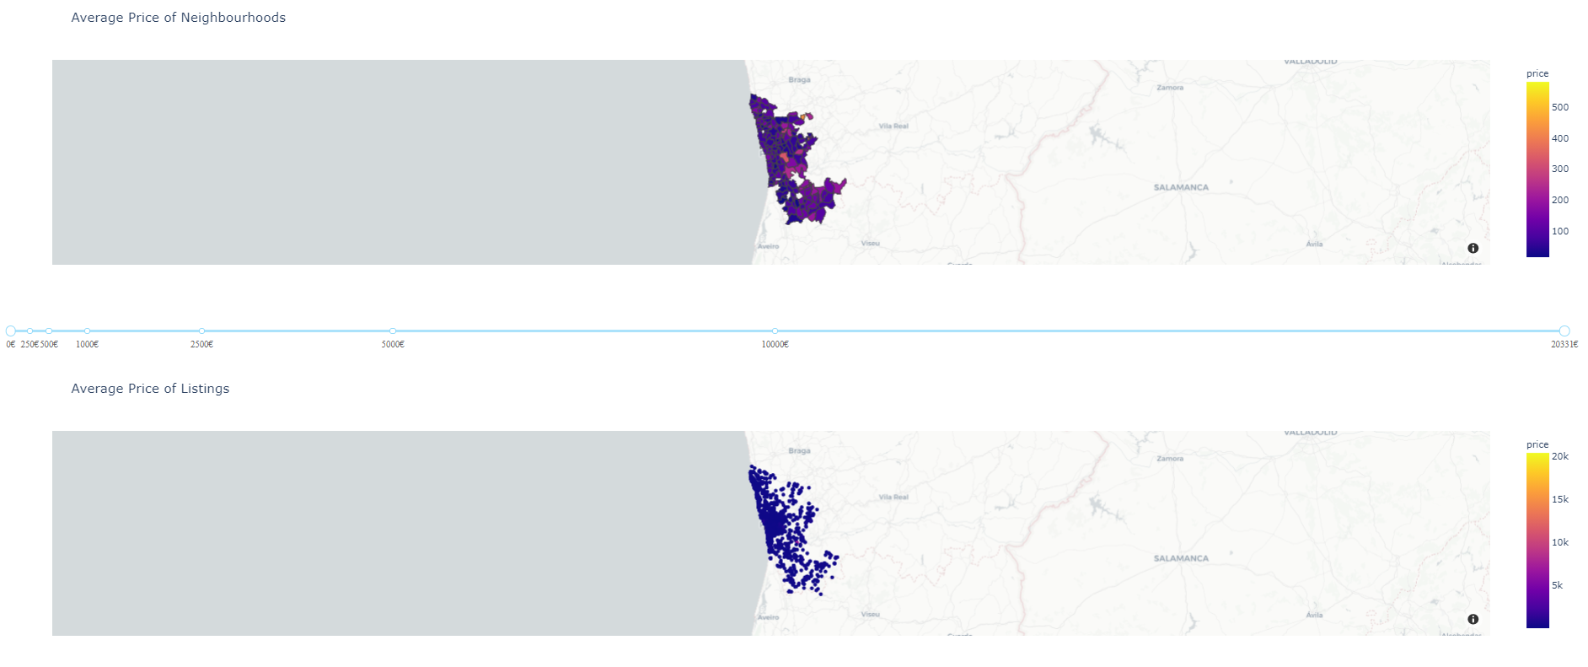
Notes:
Mapa de pontos adicionados mas vê-se mal
Slider afeta ambos
Mapa pede para ser um retângulo vertical

Slide 7
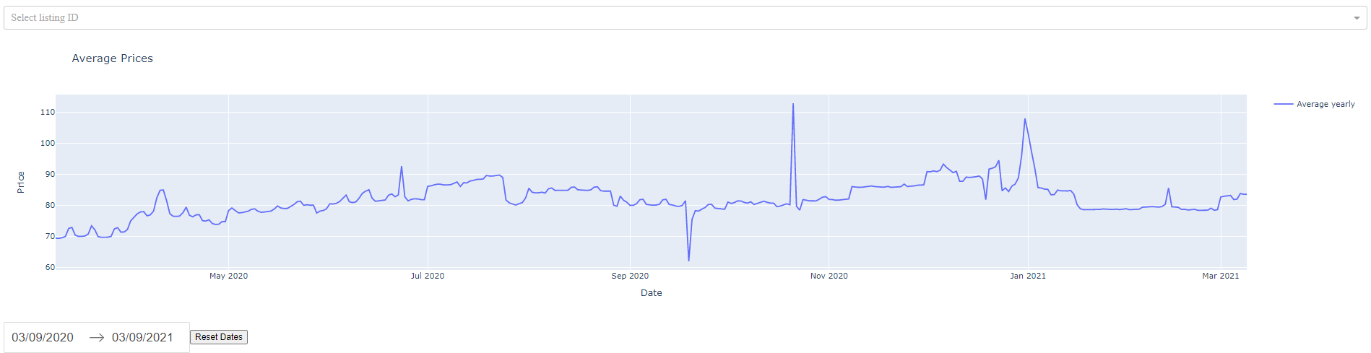
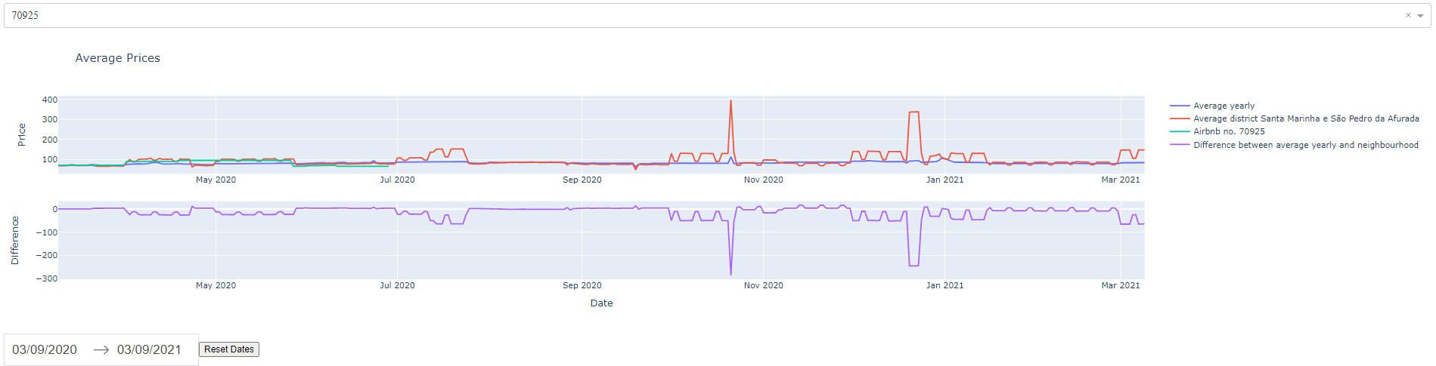
Notes:
ID é escolhido manualmente
O resto está igual à última meta

Slide 8
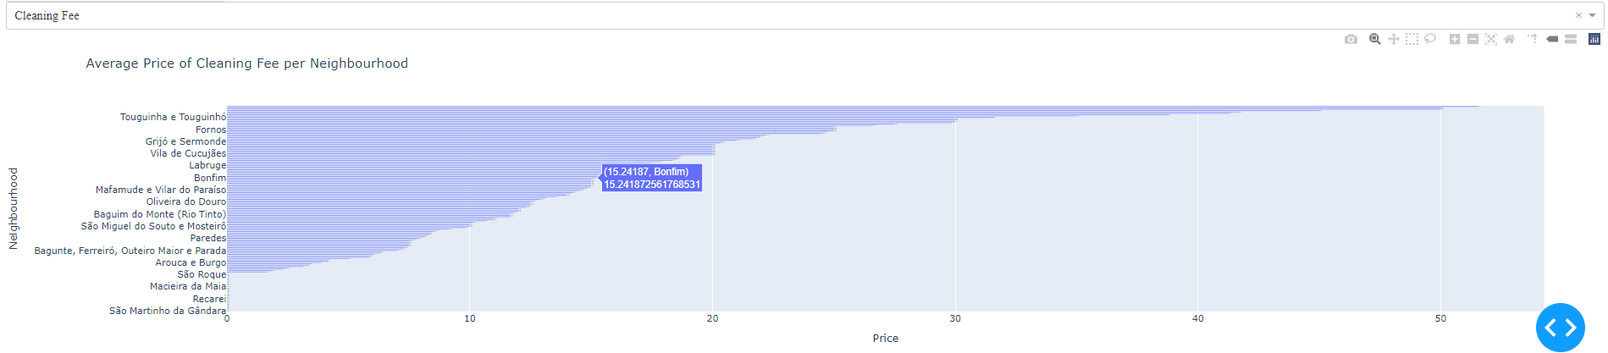
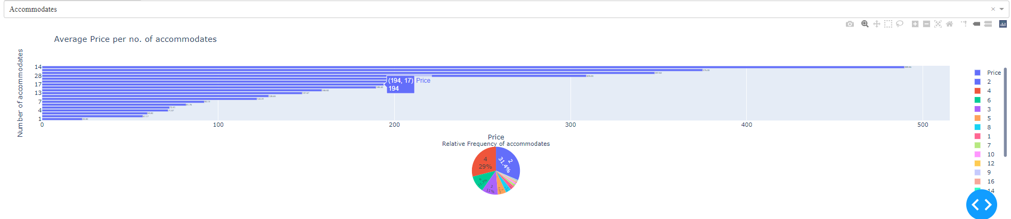
Notes:
- Sem labels decentes

Slide 9
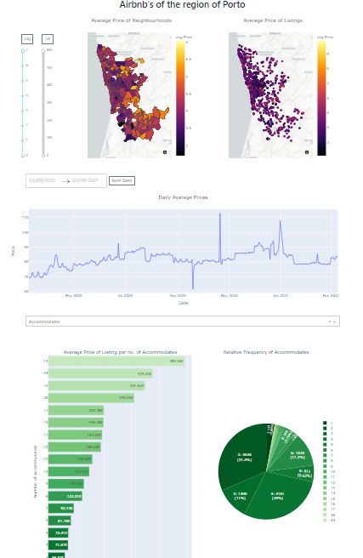
Dashboard

Slide 10
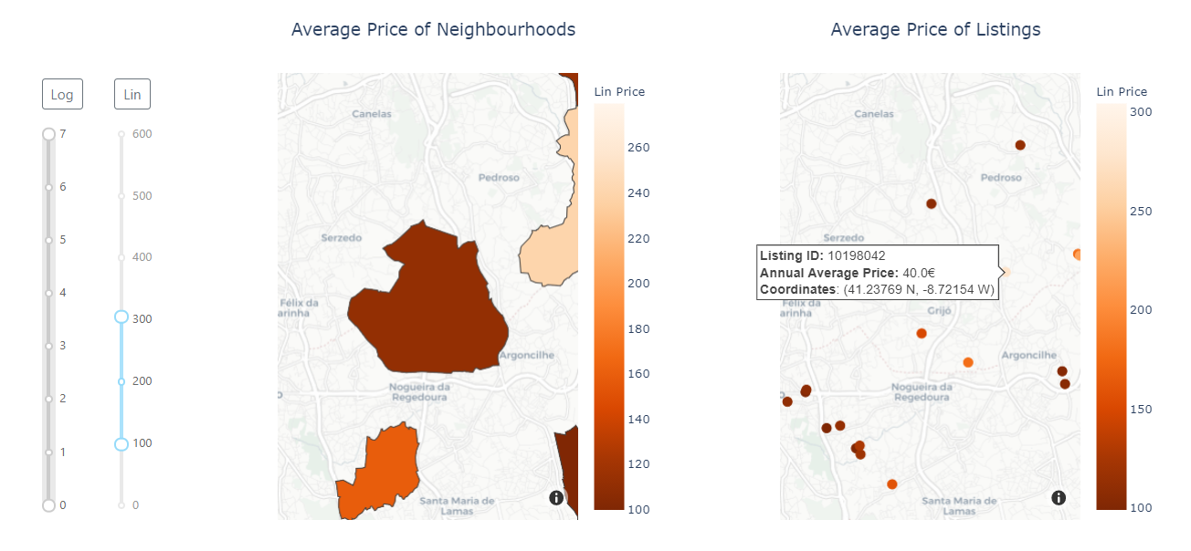
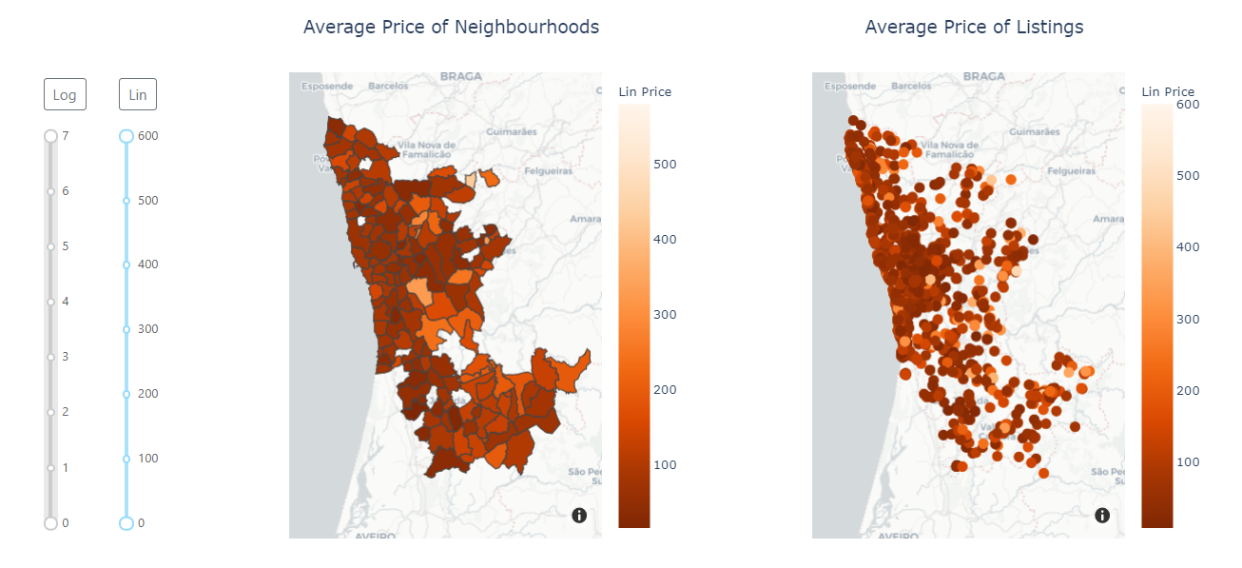
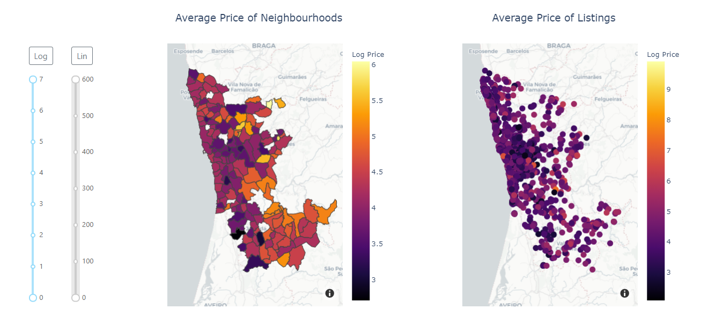
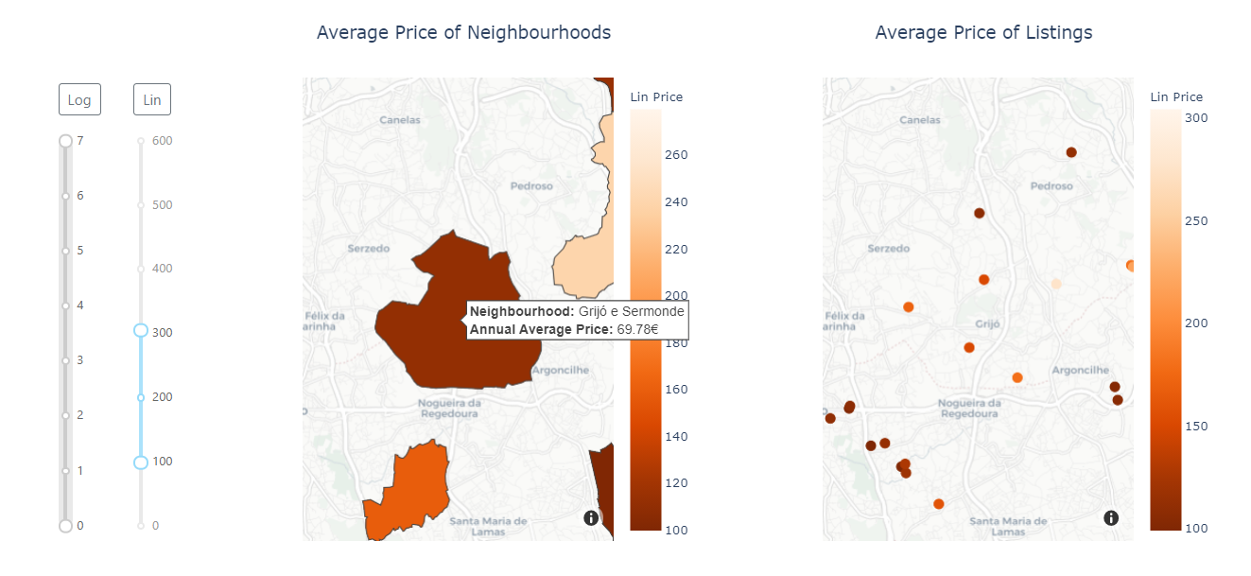
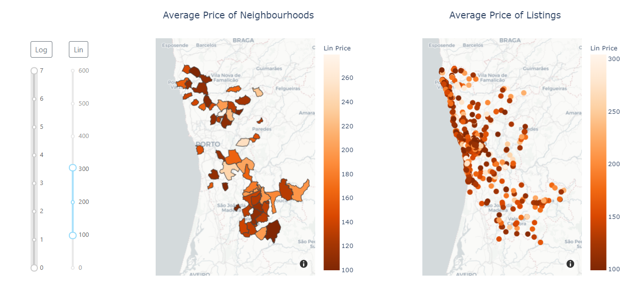
Geographic visualizations

Slide 11
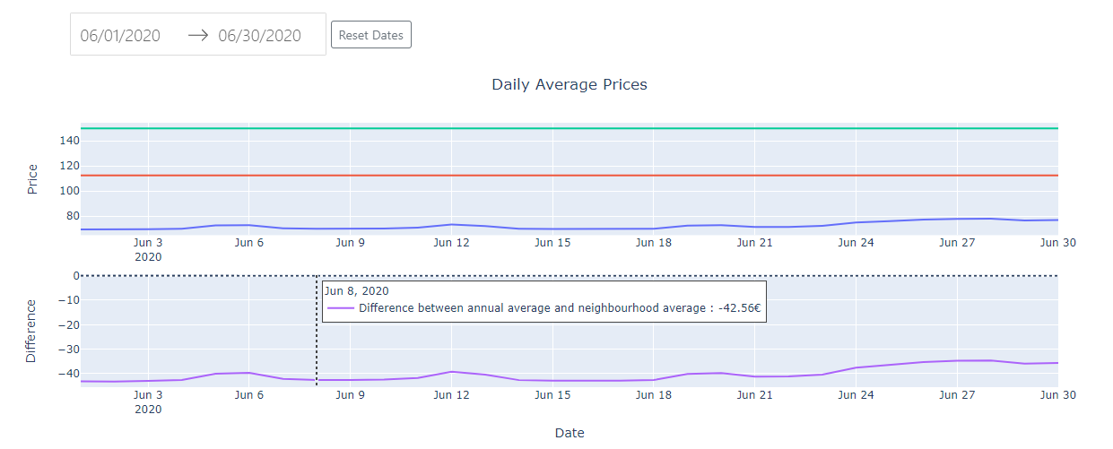
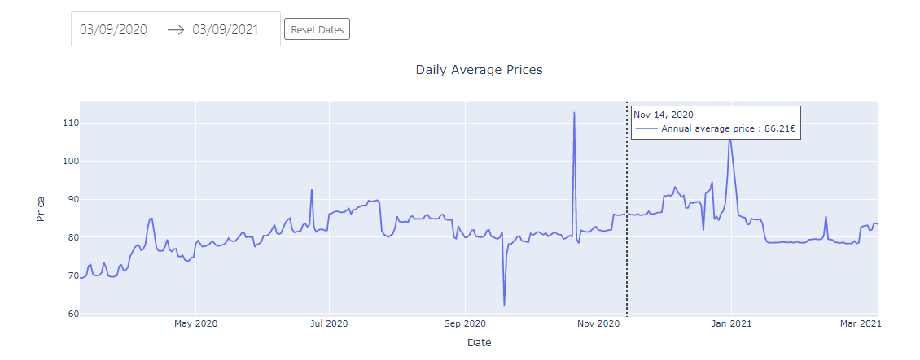
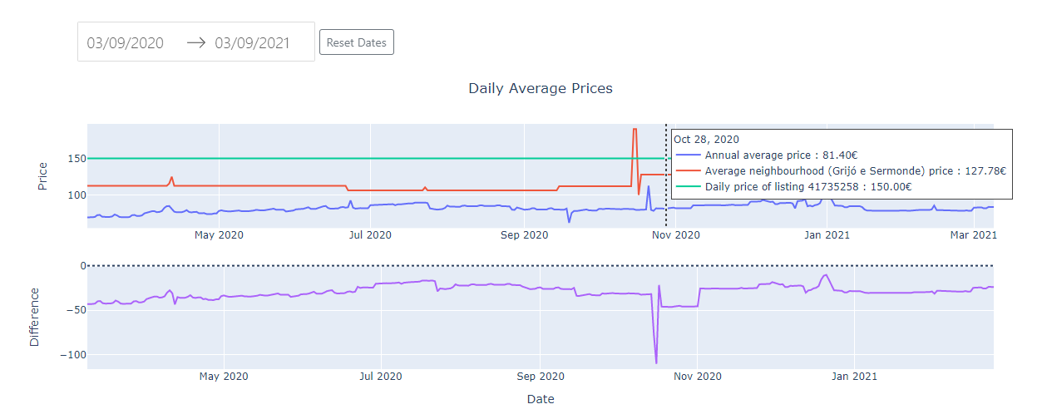
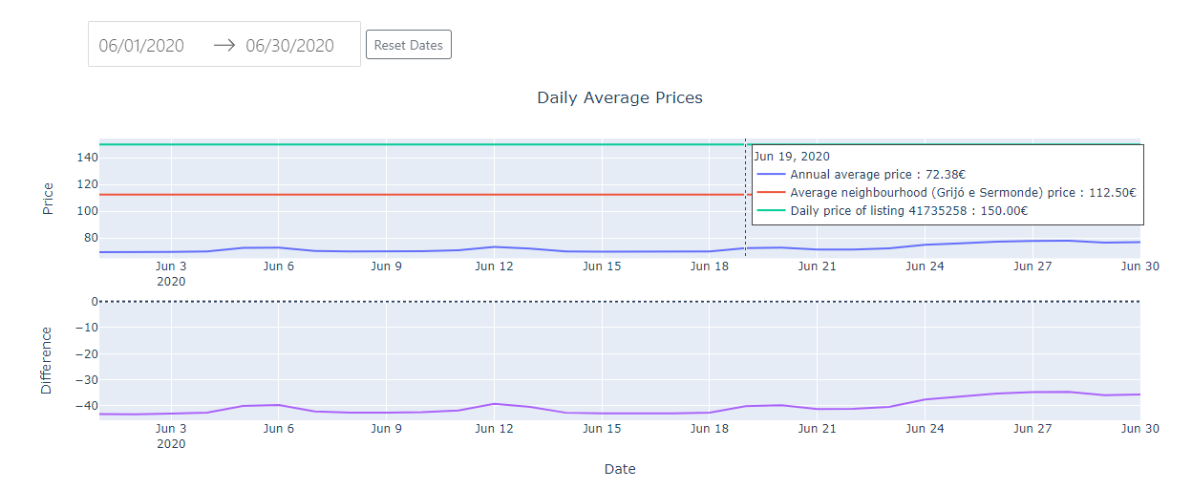
Time Series visualizations

Slide 12
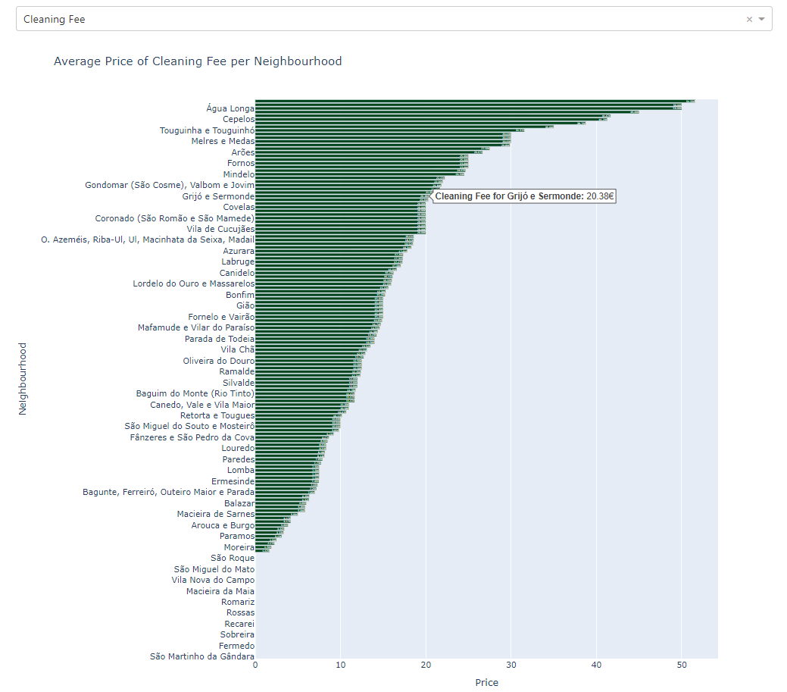
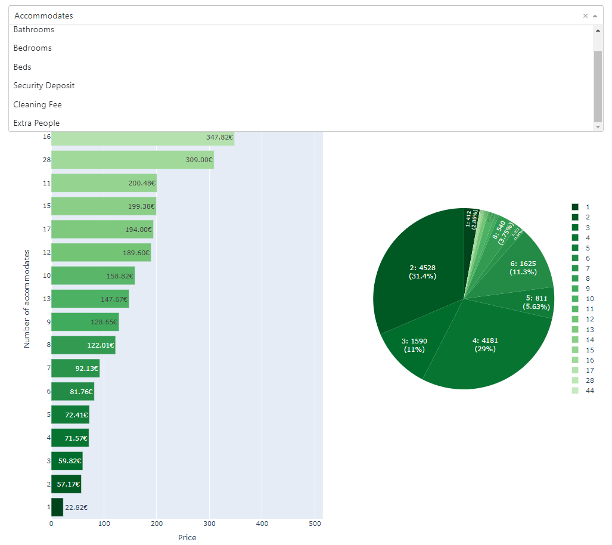
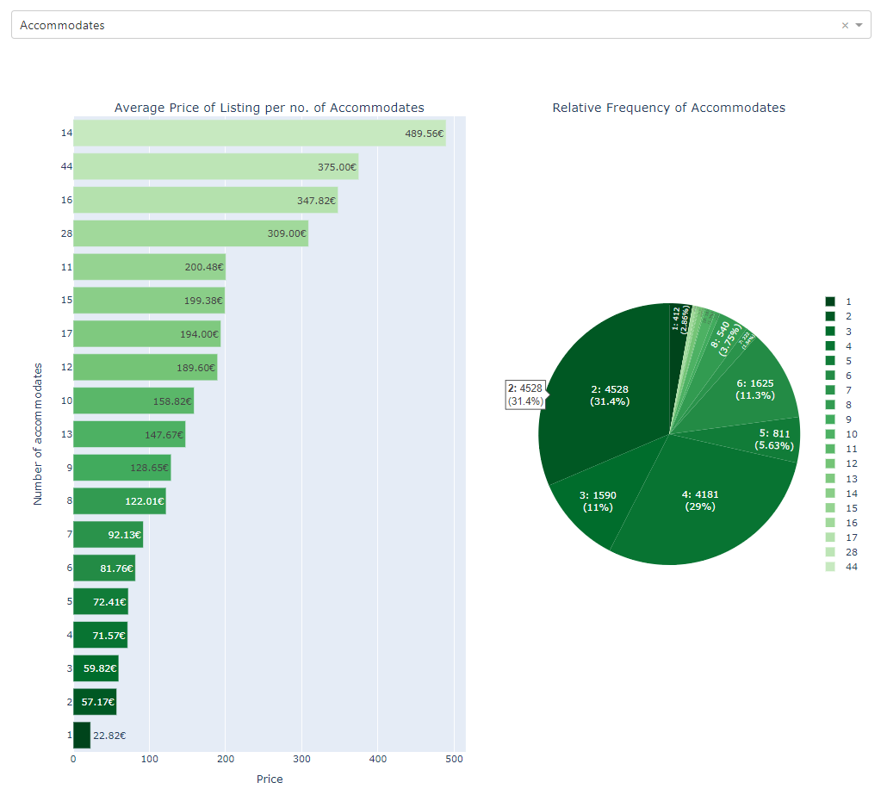

Extra visualizations
Notes:
A cor no gráfico de barras é a mesma do gráfico circular (corresponde ao mesmo)
Accommodates / Bathrooms / Bedrooms / Beds => 2 gráficos
Security Deposit / Cleaning Fee / Extra People => 1 gráfico

Slide 13

Colour palette

Slide 14
Critical Discussion
By default, linear scale instead of logarithmic scale
When pressing on a given neighbourhood, update the time series, and still zoom in on both maps

